Slide 1



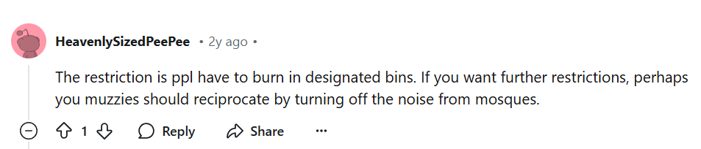
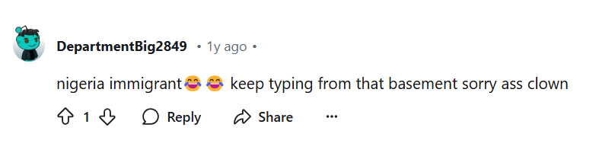
Notes:
(show example of hate/toxic comment)
I would like to start off by asking this: How many of you guys use social media like Instagram, X, or reddit? Raise your hands if you do. I believe almost everyone here uses social media every day.
Then comes the next question: Have you ever encountered such a comment online?
This is one example of the many hate/toxic comments that there are on the internet everyday and I believe that everyone would have encountered or seen such comments in the online space.

Slide 2
Online safety in social media
By Team Detoxify
Notes:
Good evening everyone, we are team Detoxify and we will be presenting on the topic of online safety in social media. I am Kylie and here are my teammates: Joy, Richmond,Sarah and Yi Jing. This is our agenda for today and I’ll start off with some background of the current situation in SIngapore

Slide 3
Agenda
01
02
03
04
05
06
Background
Methodology
Topic Modelling
Analysis & Solutions
Limitations
Future Directions
Notes:
This is our agenda for today and I’ll start off with some background of the current situation in SIngapore

Slide 4
01
Background
Notes:
I’ll start off with some background (CLICK) of the current situation in Singapore. (CLICK)

Slide 5


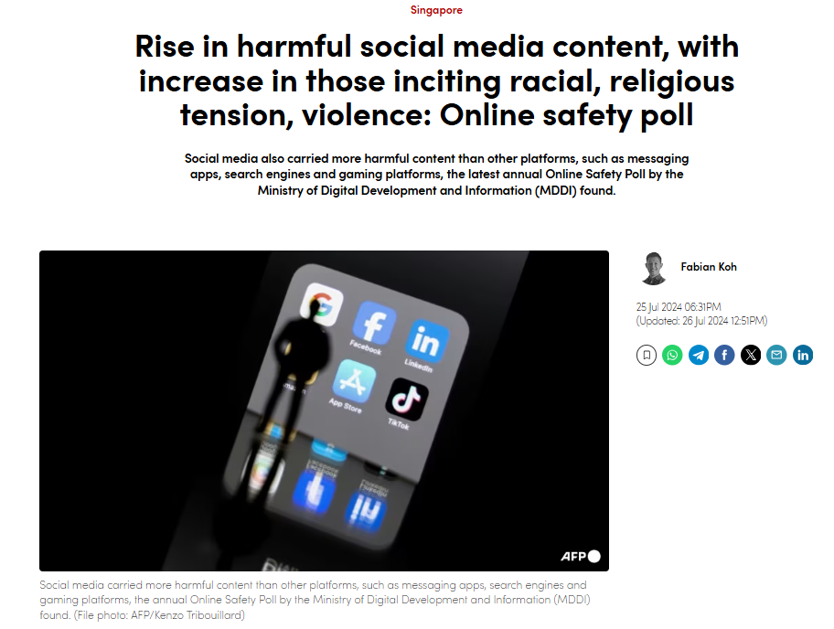


Overview of Current Situation
An Online Safety Poll conducted by the Ministry of Digital Development and Information (MDDI) in April 2024 shows a rise in harmful content exposure, with 66% of respondents encountering harmful content, up from 57% in the previous year.
Notes:
Overview + current trends in SG
With widespread use of social media -> amplified toxic and hate speech
Online safety poll by MDDI

Slide 6





Problems Faced
If left unaddressed,
will result in:
Online Safety Poll indicating an upward trend in harmful content exposure
Diminished sense of safety in online spaces
If left unaddressed,
will result in:
Lack of data on the scale and evolution of hate/toxic behaviour on Singapore-focused subreddits.
Inability to identify specific factors driving certain trends
Inability to design targeted interventions
Notes:
Problem faced by the Online Trust and Safety Team of MDDI
(Problem) The rise in online hatefulness and toxicity poses significant social risks, particularly for a diverse society like Singapore, where online discourse can influence public sentiment and community relations. With the Online Safety Poll indicating an upward trend in harmful content exposure, this results in potential consequences for youth and societal cohesion. Not addressing this problem could lead to increased polarisation, a diminished sense of safety in online spaces, and potentially a negative impact on public trust.
(Problem) team currently lacks concrete data on the scale and evolution of hate and toxic behaviour on Singapore-focused subreddits.
-> Without a detailed, historical analysis of trends in online toxicity, it is challenging for MDDI to understand the extent of the issue or to identify the specific factors driving increased hatefulness and toxicity.lack of data impedes the department’s ability to design targeted interventions and effectively engage with social media platforms to mitigate risks.

Slide 7

Gaps in Existing Methods
Use Case 1: HateBERT
Use Case 2: LionGuard
A re-trained BERT model (a transformer-based model developed by Google in 2018 for Natural Language Processing (NLP) tasks.), that is fine-tuned for English-language abusive language detection.
Singapore-contextualised moderation classifier which can identify if a text contains unsafe Singaporean slang or references.
No clear distinctions between Hate or Toxic speech
Not precise to Singapore’s context, where Singlish and slangs are used.
Does not show an intensity within each of the Hate or Toxic class.
Notes:
Limitation of some of the existing methods/features out there. I will be talking about two use cases today.
First use case: HateBERT
What it is: HateBERT was specifically designed and fine-tuned for English-language hate speech and abusive language detection. Developed by re-training BERT on English-language data from abusive, toxic, or hate-related content on platforms like Reddit, it performs well in identifying and classifying toxic content in English but is not designed to generalize across multiple languages.
Limitations: No clear distinctions between Hate or Toxic speech
Not precise to Singapore’s context
Second use case: LionGuard
What it is: LionGuard is a Singapore-contextualised moderation classifier which can identify if a text contains unsafe Singaporean slang or references
Limitations: Although text can be classified into Hate or Toxic classes, this method does not show an intensity within each of the Hate or Toxic class.
Not specific in definitions:
No clear distinctions between hate and toxic speech, just classify under a big umbrella of harmful content (e.g. Hatebert model: abusive language detection in English)
Either classify speech into hate or toxic, without going into detail regarding the intensity within each hate/toxic class. (e.g. Lionguard)
Not as precise to SG context, e.g. we use Singlish and slangs (e.g. hateBERT model)
Scoring-based system, multilingual (??) (hatebert)
and lack of intensity (lionguard)

Slide 8





Overview of our Solution: A Multifaceted Approach
Our solutions will address the 2 problems, while taking into account the gaps of existing methods.
Solutions
End goals
Aids MDDI to understand the change in online hate/toxicity intensity over the years
Able to implement targeted and specialised strategies
Insightful reporting for policy development will be implemented.
An automated hatefulness/toxicity detection pipeline with precise definitions to the SG context will be developed.
Notes:
Overview of solution
Our soln combines addresses the two problems while taking into account both limitations, becoming a multifaceted approach.
Our soln will be able to:
Insightful Reporting for Policy Development: Generate clear, data-backed insights on hate and toxic speech in the online environment, by observing trends over the recent years (2020 to 2023) and the specific factors and subjects involved. These meaningful insights will be able to support MDDI in their policy recommendations and interventions to curb the problem in a precise manner. MDDI can then implement actionable strategies, including the engagement of various stakeholders like social media companies, to aid in reducing the exposure of such of these harmful content.
Automated Hatefulness/Toxicity Detection Pipeline: Develop a reliable pipeline that automates the processing and classification of Reddit comments into its specific hatefulness or toxicity intensity level. This automation will be able to read in a Reddit comment, before classifying it into one of the 7 categories under the Language Intensity Classification system defined by us. This system will increase MDDI’s capacity to monitor and analyse social media content efficiently, with minimal manual intervention. In addition, with the classification of comments into one of the specific 7 categories, MDDI can better understand the change in intensity of online hate/toxicity trends over the years, the causes driving these trends and ultimately implement targeted and specialised solutions.
More details of this classification system will be explained in the later slides.

Slide 9
02
Methodology
Notes:
That sounds like a comprehensive approach. To achieve that, how can we leverage our data? (CLICK)

Slide 10

Defining Intensity-based Classes
Sensitive group: Nationality, Race, Ethnicity, Religion, Gender, Sexual orientation, Disability, Skin color, Age, Generational group, Socio-economic status, or Immigration status.
Working hours in SG so long, so annoying
you are such a loser
you are such a loser, get out of this place or else I will kick you
Increasing intensity of Hate
Increasing intensity of Toxicity
Hate 1
Hate 2
Hate 3
Toxic 1
Toxic 2
Toxic 3
No Hate/Toxic
Bias or generalizations without exclusion or incitement.
Exclusion or denial of rights, including denial of access, rights, or opportunities based on group characteristics.
Incite harm or make threats.
Mild complaints or disrespect without direct insults or threats.
Insults, sarcasm, or mocking, focusing on humiliation or belittling.
Harassment or encouragement of harm.
Neutral or constructive comments, including playful sarcasm.
Aim: Capture a range of toxic and hate intensities from the comments
Notes:
From our data, we want to use the definitions of 7 intensity-based classes to (CLICK) capture a range of (CLICK) toxic and hate intensities.
What's the difference between hate and toxic you may ask?
Hate comments target (CLICK) these sensitive groups directly, while toxic comments do not.
This choice of groups align with Singapore’s legal framework against harmful speech.
Hate comments intensify from (CLICK) biases without exclusion, moving towards (CLICK) actions that exclude or deny rights, and (CLICK) escalating to comments that incite harm or make explicit threats.
On the other hand, Toxic comments do not specifically target sensitive groups.
beginning with (CLICK) mild complaints like “start work sg time, end work india time. Seriously damn bullshit”, progressing to (CLICK) insults like “you are such a loser in life” which can be belittling.
At the highest (CLICK) intensity, it involves harassment or encourages harm such as “you are such a loser in life, get out of this place or else i will kick you”.
(CLICK) Lastly, we also identify No Hate and toxic comments.

Slide 11
1.
2.
Multiclass Text Classifier
Topic
Modelling
Notes:
Next, we train a multiclass text classifier that identifies and categorizes speech into the 7 classes, then we analyse the comments identified as hateful and toxic using topic modelling. (CLICK)

Slide 12


Data Labelling
GPT-4o mini
Subset size: 400,000
Word count range: 5 - 50 words
Sampling method: Random
Cost-effective Large Language Model (LLM) shown to perform impressively at text tasks
Cleaning
Subsetting
Labelling
~4.5 million Reddit comments from 2020-2023
Notes:
To train our classifier, we started by (CLICK) cleaning 4.5 million Singapore-focused subreddit comments, reducing it to 4.3 million usable comments.
However, labeling every comment wasn’t feasible due to the massive data size requiring a costly amount of processing resources. (CLICK)
So, we created a focused subset of 400,000 comments. The word count range was chosen because over 70% of our dataset falls within it. (CLICK)
For labeling, we used GPT-4o mini via API calls. For being cost-effective and showing better accuracy in matching our custom classifications compared to other tested models like Llama3 and Mistral. (CLICK)

Slide 13

Synthetic Data Generation for Balanced Classification
Problem: Imbalance
Minority classes (i.e., Hate 2, Hate 3, Toxic 2, Toxic 3) significantly underrepresented
Solution: Template-Based Synthetic Data Generation
Obtain 15,000 examples per class
Balance minority classes
Avoid excessive synthetic data
Approach:
1. Create templates to reflect specific tones and language for Hate/Toxic categories
2. Combine templates with {actions} and {group} references to create synthetic comment
Notes:
The labelled data revealed significant class imbalance, resulting in poor predictions of some classes.
Initially, we addressed this using a common technique called SMOTE.
However, when applied to text data it essentially equates to randomly duplicating observations in minority classes, thus it could not capture sufficient variations in language to train the classifier
Instead, (CLICK) we used a template-based data generation approach to get 15000 for each class without excessive generation.
(CLICK) In an example, we take a Template like “if sensitive group dont action, they will threat”
(CLICK) Combined with fillers like (CLICK) actions and sensitive group references
To (CLICK) form a Hate 3 class comment (CLICK)

Slide 14
Example
If
chinese
don’t
pack up and leave
they will wish they never showed up
{sensitive group}
{action}
{threat}

Slide 15
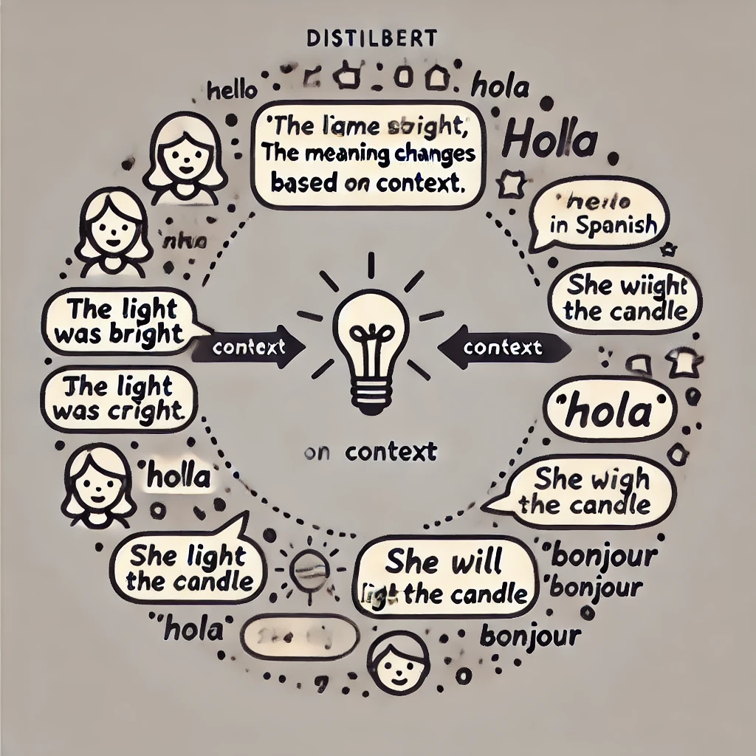
Leveraging DistilBERT for Multiclass Classification
1. Traditional Machine Learning
Models Used:
Ridge Regression, XGBoost, Naive Bayes, Linear SVM
Text Processing:
Lemmatization using NLTK
Term Frequency-Inverse Document Frequency (TF-IDF)
F1-score: 0.81
2. Fine-tuned multilingual DistilBERT model
Multilingual Capability:
Tokenizer trained on 104 languages
Contextual Understanding:
Processes words in context
Fine-tuning:
3 epochs
Scheduler to adjust learning rate to stabilize training
Dropout to reduce overfitting
✅
F1-score: 0.84
Notes:
Next, we compared DistilBERT and traditional machine learning Classifiers. (CLICK)
As we observed different F1 scores per class, We used the macro-average F1-score to equally weigh each class and assess overall performance.
Using modes like Ridge Regression (CLICK) we achieved a best F1-score of 0.81.
While effective, it struggles with complex language. (CLICK)
DistilBERT is a lightweight and powerful AI language model that understands context between words.
Its multilingual capability helps it capture slang and nuanced hate speech more effectively.
(CLICK) Leading to a higher F1-score of 0.84.
While traditional models are reliable, DistilBERT’s contextual understanding makes it the superior choice for detecting real-world hate speech.(CLICK)

Slide 16


Leveraging DistilBERT for Multiclass Classification
deport all the useless migrants back to their home, if they dont leave asap, i will destroy them
将所有无用的移民驱逐回家乡，如果他们不尽快离开，我就消灭他们
mengusir semua pendatang yang tidak berguna kembali ke rumah mereka, jika mereka tidak pergi secepat mungkin, saya akan memusnahkan mereka
பயனற்ற புலம்பெயர்ந்தோர் அனைவரையும் அவர்களது வீட்டிற்கு திருப்பி அனுப்புங்கள், அவர்கள் விரைவில் வெளியேறவில்லை என்றால், நான் அவர்களை அழிப்பேன்
Comments in different languages Classified as Hate 3
Deportaré a todos los inmigrantes inútiles a sus hogares, si no se van lo antes posible, los destruiré.
Notes:
The power of DistilBERT’s multilingual capability means our classifier isn’t limited by language barriers.(CLICK) Imagine an English comment flagged as severe hate speech—Hate 3. We tested that same comment(CLICK) translated into Chinese, (CLICK) Malay, (CLICK) Tamil, and (CLICK) Spanish. (CLICK) Each time, DistilBERT detected it as Hate 3.(CLICK)

Slide 17

Training and Evaluating Multiclass Classifiers
 | DistilBERT | DistilBERT (old)
No Hate/Toxic | 0.72 | 0.45
Toxic 1 | 0.61 | 0.21
Toxic 2 | 0.79 | 0.34
Toxic 3 | 0.98 | 0.08
Hate 1 | 0.79 | 0.40
Hate 2 | 0.97 | 0.60
Hate 3 | 0.99 | 0.57
**Macro-average F1-score | 0.84 | 0.39
+0.45
*Both models evaluated on the same test set
** Macro-average F1-score to equally weigh each class and assess overall performance.
Notes:
Beyond just comparing models, we aimed to evaluate how our updated multiclass definitions impacted performance. We compared our new DistilBERT model, trained with well-defined class distinctions, against an older version trained on less precise definitions.
The results show a (CLICK) significant improvement: the updated DistilBERT achieved almost 40% higher F1-score on the same test set, demonstrating changes in definition impacts the actual training of our model.
DistilBERT’s classifier shows strong performance across multiple languages at distinguishing subtle differences in hate and toxic speech. (CLICK)

Slide 18
03
Topic Modelling
Notes:
Next, let’s dive into analyzing the labeled dataset!

Slide 19

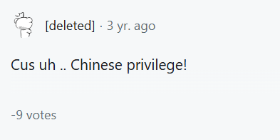
Topic Modelling
13 main themes:
1. Race
2. Crimes
3. Gender
4. Education
5. COVID-19
6. Generational
7. Government
8. Housing
9. LGBTQ+
10. Religion
11. Transportation
12. Work
13. Body Image

Slide 20
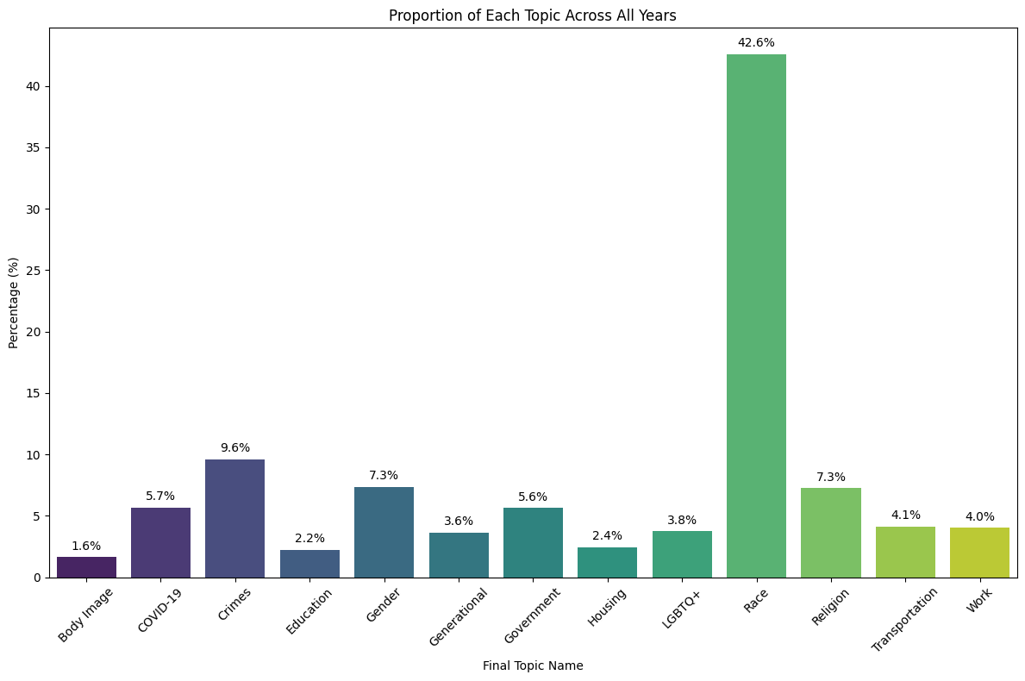
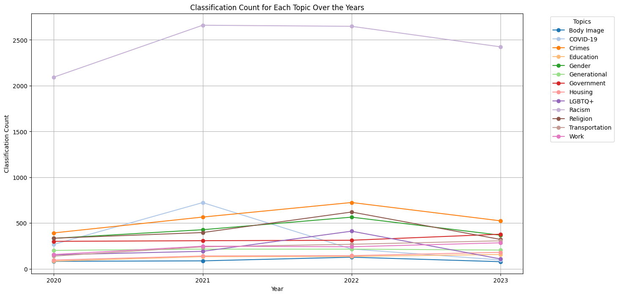
Frequency Analysis
Frequency of hate and toxic for each topic for all years
Frequency of hate and toxic for each topic across each year

Slide 21
Imagine ……
You stupid ah,bro?
You stupid ah,bro?
VS
Just go and die lah
You stupid ah,bro?

Slide 22
Intensity Analysis
Calculate Indices for each Intensity level (e.g. Toxic 1, Toxic 2, Toxic 3)
Find Yearly Percentage Change of Index for each Intensity Level
Calculate Net Hate/Toxic Trend
Toxic 3 Index 2020 =
Number of Toxic 3 Comments
All Toxic Comments in 2020
Toxic 3 Change 2020-2021 =
(Toxic 3 Index 2021- Toxic 3 Index 2020)
Toxic 3 Index 2020
Net Toxic Trend 2020-2021 =
Toxic 1 Change * 1 + Toxic 2 Change * 2 + Toxic 3 Change * 3

Slide 23
Intensity Analysis
3kg
Calculate Net Hate/Toxic Trend
Toxic 3
Toxic 3
Toxic 2
Net Toxic Trend 2020-2021 =
Toxic 1 Change
+ Toxic 2 Change
+ Toxic 3 Change
*1
Toxic 1
Toxic 1
*2
*3
1kg

Slide 24
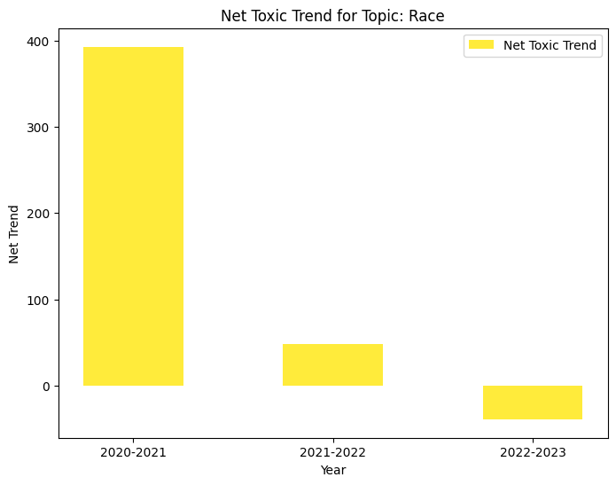
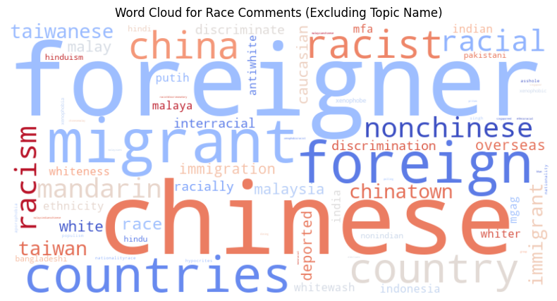
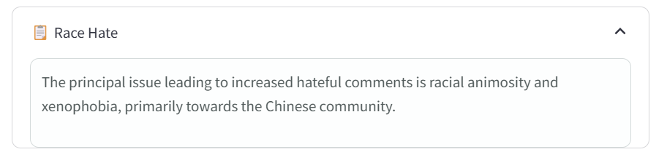
Intensity Analysis
Focus on years with positive Net Hate/ Toxic Trend
Retrieve Common Subtopics
Generation of Problem Statement

Slide 25
04
Analysis & Solutions
Race
Crime

Slide 26
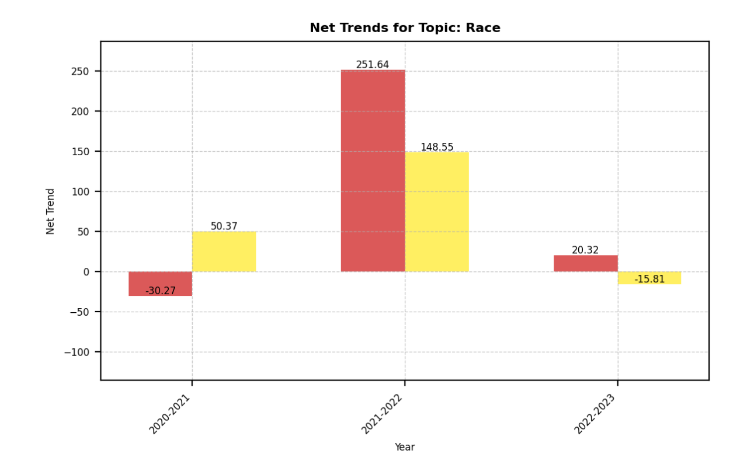
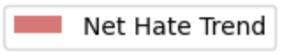
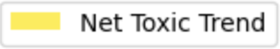
Race

Slide 27
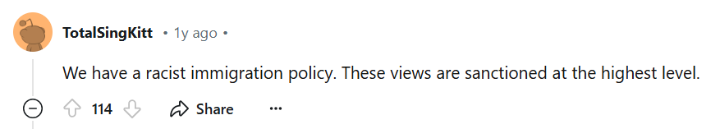
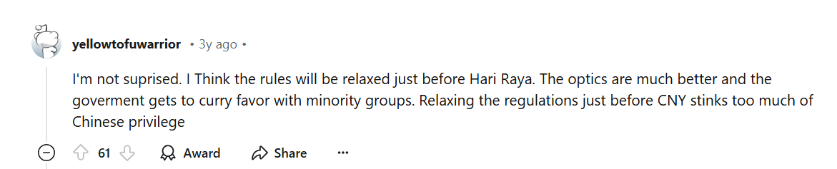
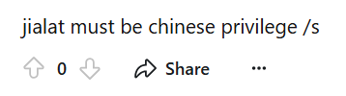
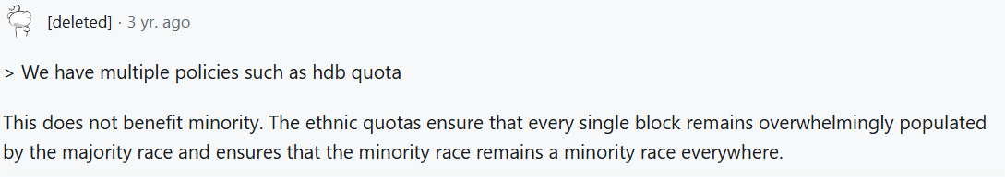
Race Toxic

Slide 28
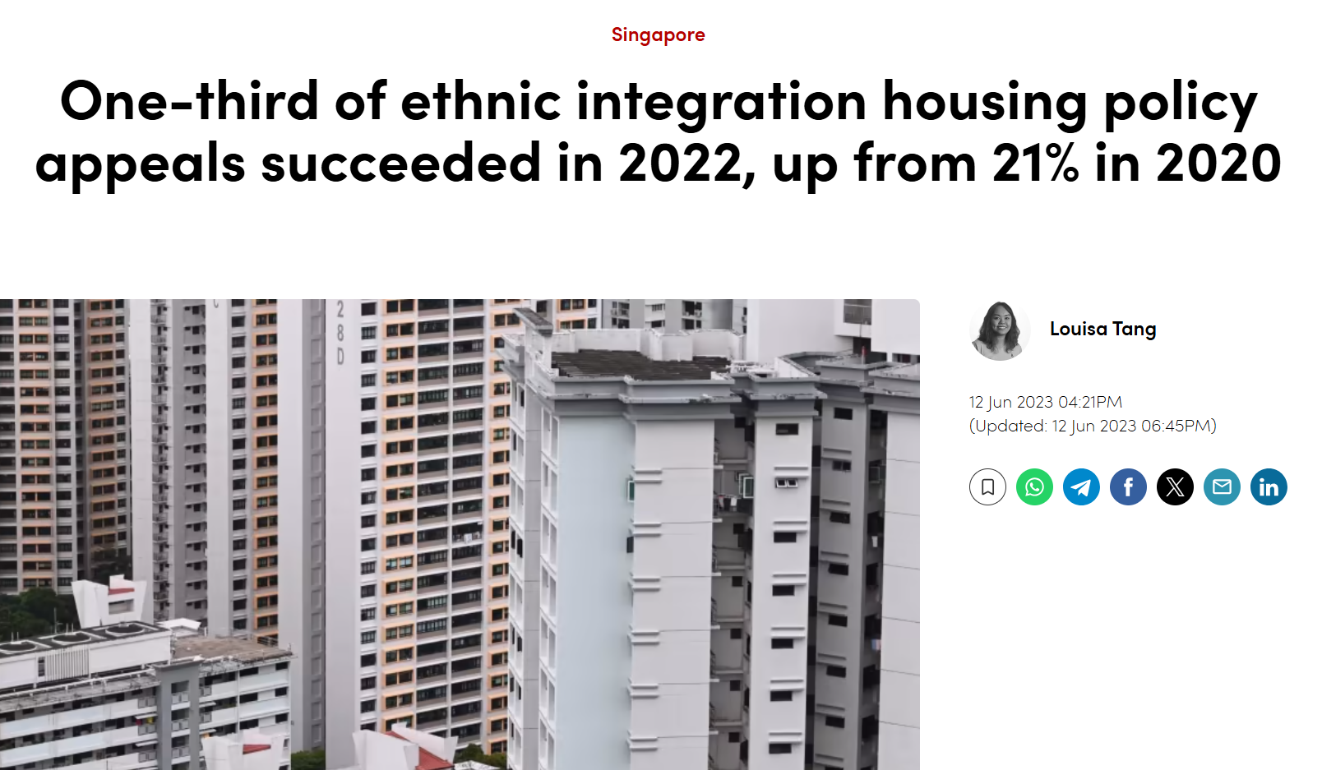
Solutions
National Day Rally 2021
Chinese Singaporeans - who make up 76 per cent of the citizen population - to be understanding and accommodating of the concerns and difficulties faced by ethnic minorities here, especially in the areas of renting homes and looking for jobs.
the government responded by offering flexibility, responding to the appeals of affected groups
collaborate with other ministries to constantly evaluate and refine policies
encourage greater interaction and build empathy amongst different racial groups

Slide 29
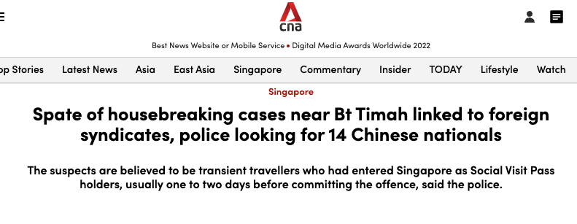
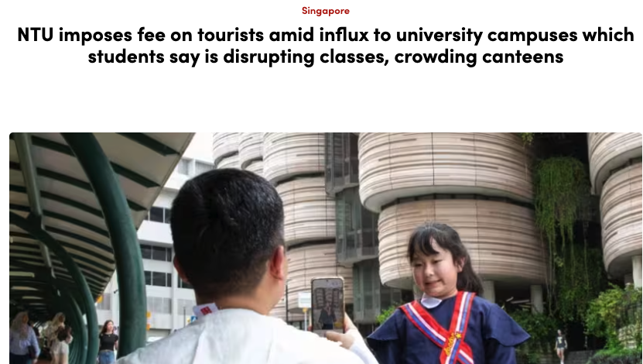
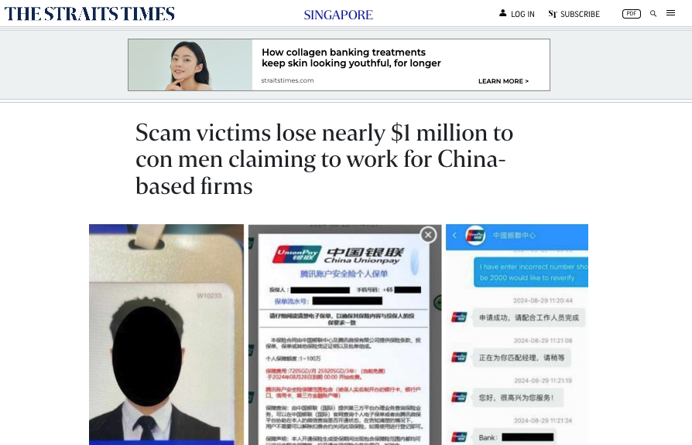
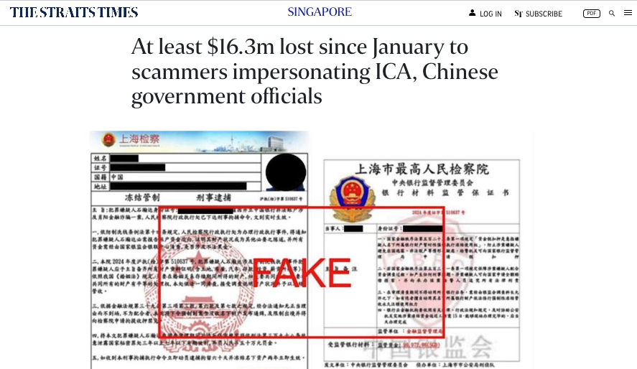
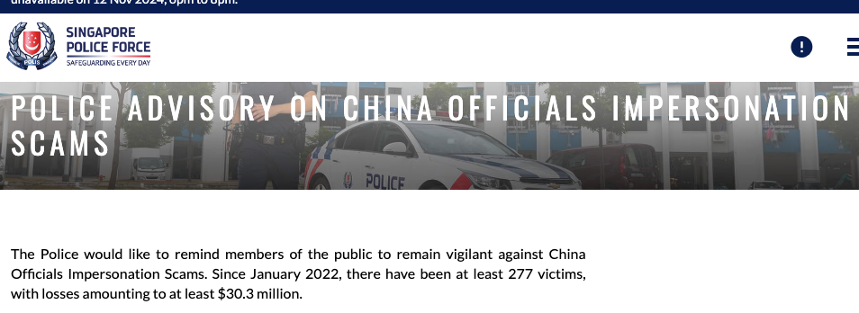
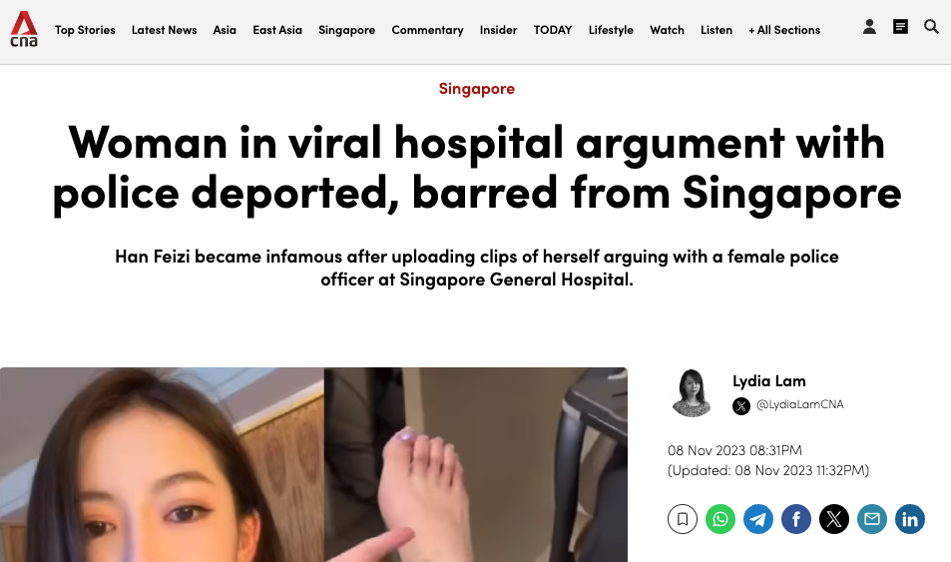
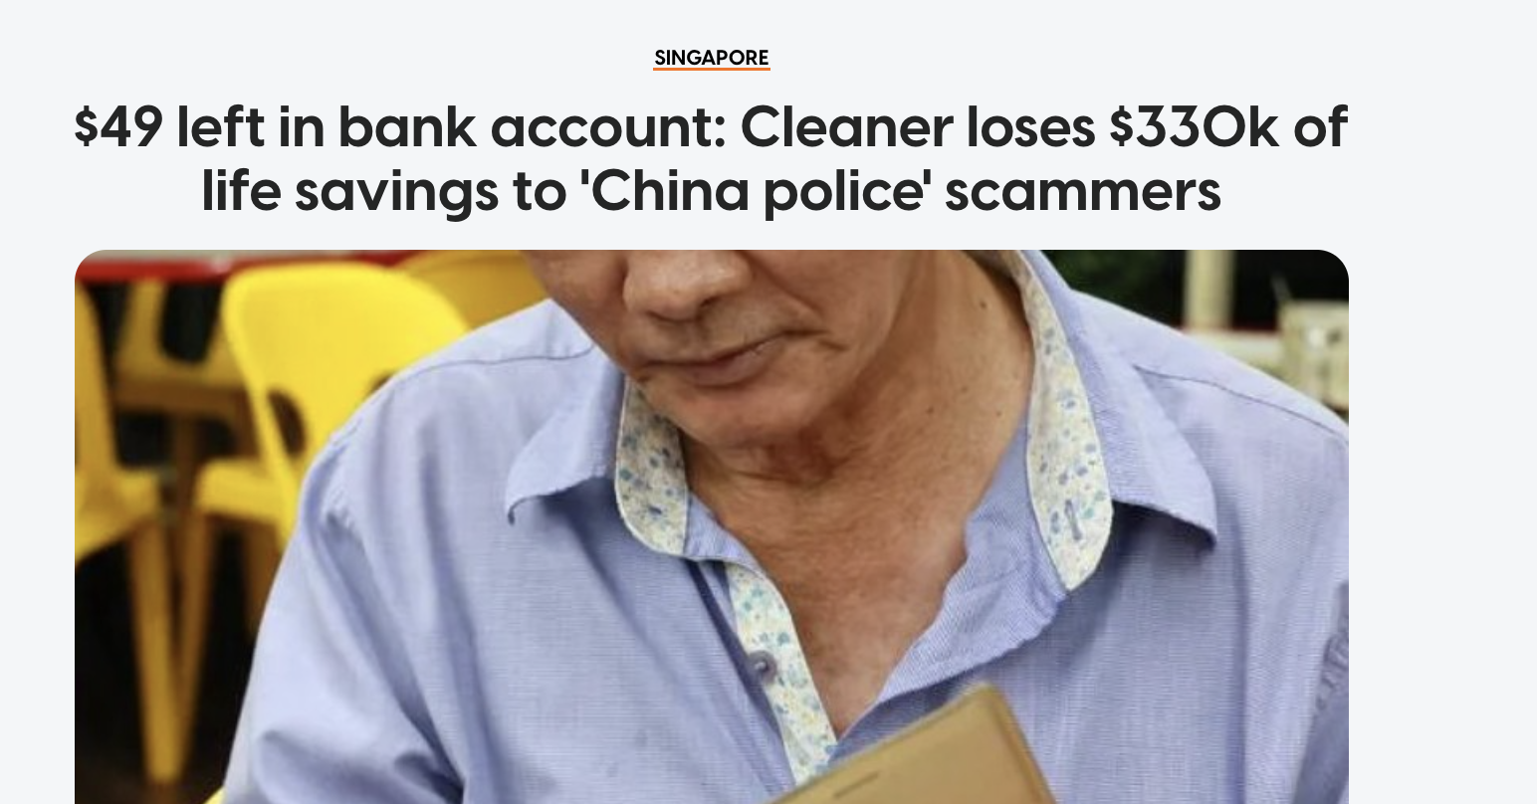
Race Hate
Hate speech targeting Chinese nationals increased
Trigger widespread backlash against chinese nationals as a group
Anything remotely related to Chinese officials and cops should be blocked and hung up immediately. Remind your elderly family members
Go back to China, you parasitical fuck
Notes:
4 clicks for 4 articles
For race hate, we found out that hate speech targeting chinese nationals noticeably increased, and this is particularly influenced by specific incidents involving individuals of this nationality.
In 2023, an incident that captured media attention involved a Chinese woman who verbally abused hospital staff and fought with the police. This event triggered significant online backlash, including a comment telling her to ‘go back to China.’
Another comment which reads Anything remotely related to Chinese officials and cops should be blocked and hung up immediately. Remind your elderly family members comment comes from a case where a cleaner lost his life savings to fraudsters impersonating Chinese police
Even until this day, many such cases *click* will further tarnish the image of chinese nationals, which means solutions for this is extremely important

Slide 30

Solutions
01
Encourage balance reporting for fair representation
02
Enhance security measures
Notes:
In response to challenges discussed, several solution can be implemented.
Firstly, the pollicy team can collaborate with the media for fair representation by encouraging balanced reporting highlighting the positive contributions of the Chinese community, which often go unnoticed amidst negative stereotypes.
Secondly, educational outreach on scam prevention for at-risk groups is essential, for example, t the elderly who are more likely to fall prey to such scams. This can include information on how to recognize and report scams
Lastly, enhancing legal and security measures is imperative. This includes developing international cooperation to tackle scams and mandating financial institutions to upgrade their security and transaction monitoring systems

Slide 31
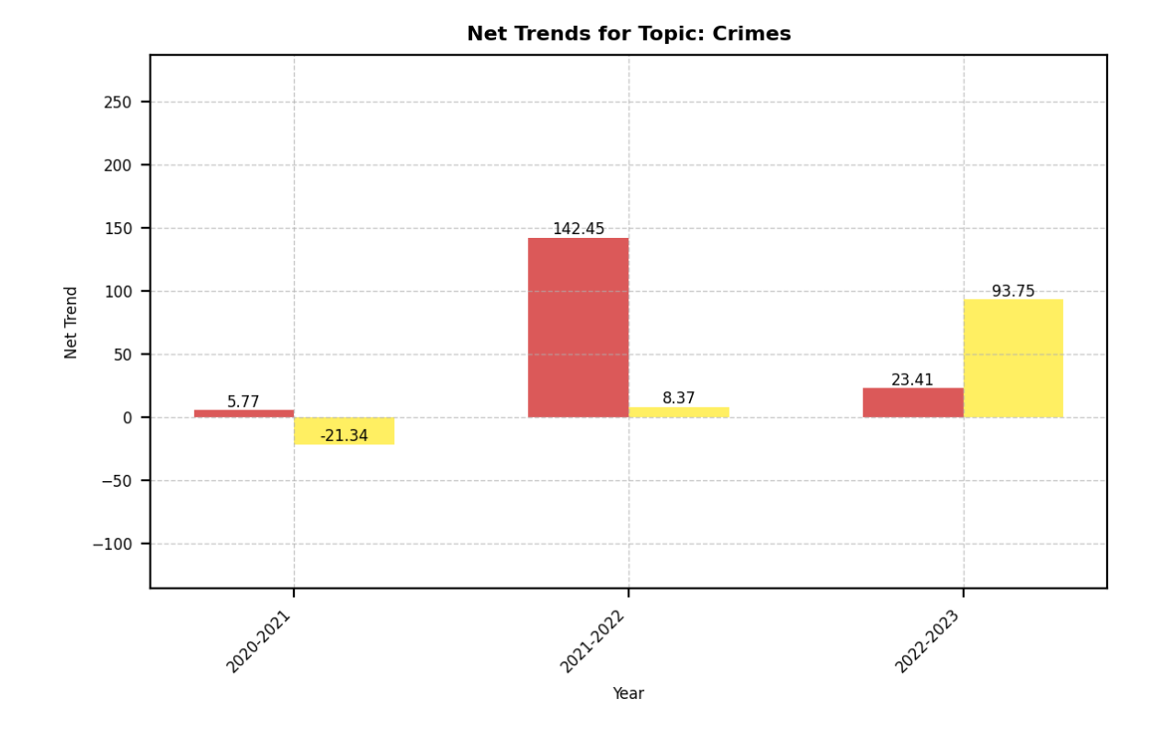
Crime
Notes:
For the topic on crime we can see that
Increase in Toxicity in year 2022 and year 2023
Increase in Hate for all years.

Slide 32
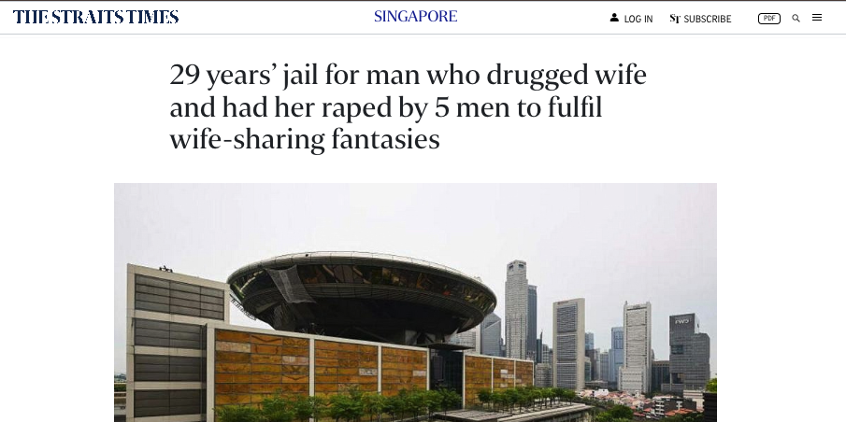
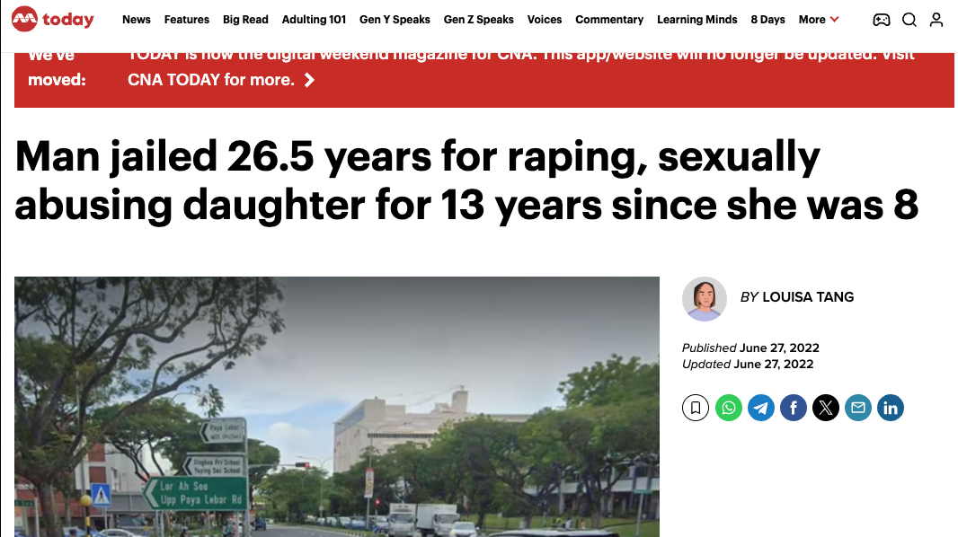
Crime Toxic
Sexual crimes
Imagine making children with someone who ends up arranging for u to b raped... with your kids in the other room I need to see caning!!
His own daughter…Humans should all be fucking wiped out. I'm sorely disappointed in Covid,
Extreme anger and demands for more severe punishment, particularly in area of sexual crimes
Notes:
For toxic speech in crimes, analysis of public comments related to criminal cases on social media reveals a prevailing trend of extreme anger and demands for severe punishment, particularly in response to sexual crimes. Some sexual crimes was so appalling that it caused public outrage.
For example, in a case that even reached international new was an incident where four husbands conspired to drug and rape each other’s wives. This crimes was so heinous, with comments asking for stronger punishment like this reddtor that ask for caning
Another case saw a man sexually abusing and raping his own daughter for 13 years, comemnts responding to this case included many toxic speech like “humans should be wiped out” or “hang him” , highlighting a collective sentiment focused on retribution
This response shows a need for a balanced approach to criminal justice that includes effective punishment and preventive measures

Slide 33


Solutions
01
02
Education campaign to shift perception away from punishment
Relook at sentencing guidelines; publicly communicate sentencing reforms
Notes:
To effectively do this
Firstly, education campaign can help raise awareness on cause and consequence of sexual offense to shift publics perception from punishment to understanding the factors that drive cirminal behaviour
Secondly, policy tean can relook at sentencing guidelines for sexual crimes to ensure its appropriately stringent and any sentence reforms should be publicly communicated to assure community that justice is seved.

Slide 34
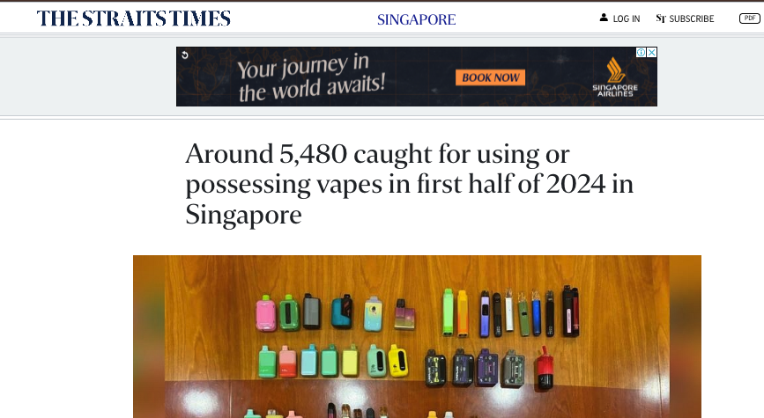
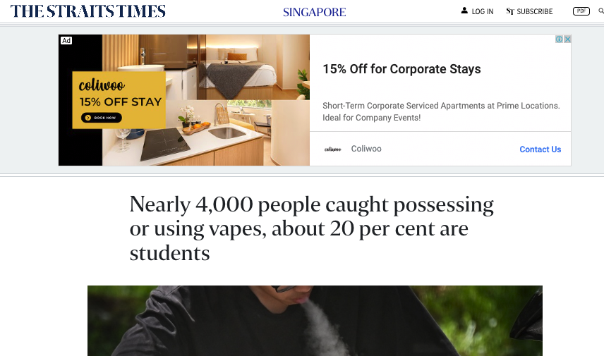
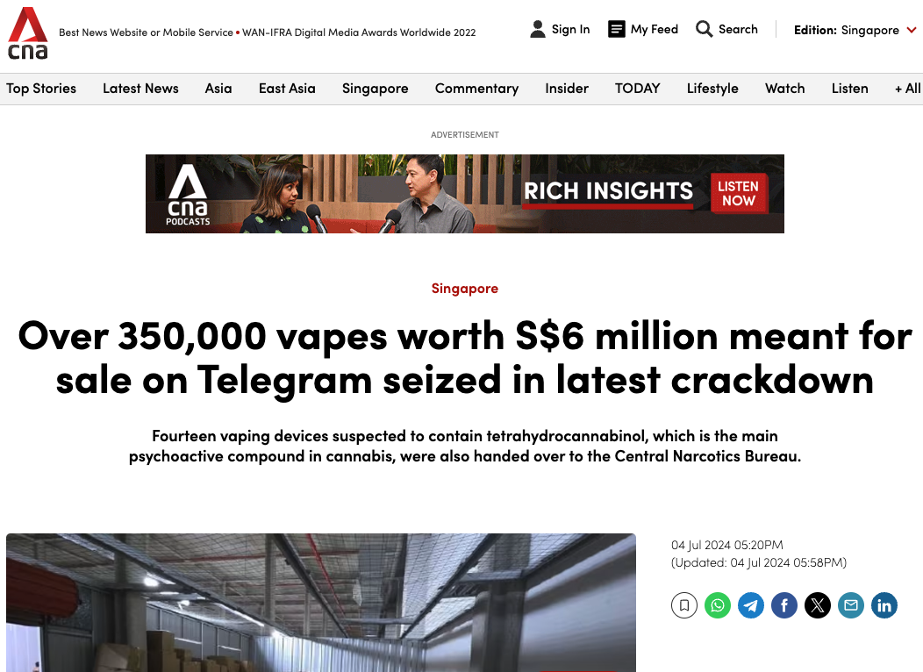

Crime Hate
Ya, don't ruin it for others. Once SPF think there's too many this kind of ppl implying not enough enforcement they're gonna come down hard, which applies to not just vapes but most stupid laws in SG. This is why we can't have nice things, because of such idiots
Discontent with youths that vape openly
Done discreetly, escape legal scrunity
WRONG MENTALITY!
Notes:
3 clicks to show image
There is a substantial hateful comments on the topic of youth that vapes. One of the comments as seen from the screen chides those that vapes openly, saying that the police will enforce even more stricter rules. This reveals the current mentality that youths have, suggesting that if vaping is done discreetly behind close doors, it might escape legal scrutiny.
Such attitude highlights the challenge authorities face in ensuring compliance not through fear of increased enforcement alone but through broader cultural shifts and understanding of the laws’ purposes.
In addition, Vaping among youth has actually seen a significant rise, as seen here
Even in recent years suggest this is an important issue to tackle

Slide 35


Solutions
01
02
Target reasons why youths turn to vaping
Focus on rehabilitative measures, not compliance through fear
Notes:
Current measures to curb youth vaping are more focus on disciplinary action instead of addressing root cause. Thus, the policy team can educate beyond just risk of vaping but target the reasons why youth starts vaping. Examples include having better stress management strategies, increasing their ability to resist peer pressure or other healthier alternatives
In addition, legal penalties can also be adjusted to incorporate rehabilitative measures rather than disciplinary actions, such as focusing on educational penalties where young offenders for example, have to attend programs that highlight danger of vaping

Slide 36
06
Key Findings

Slide 37


Improved Model Performance with Refined Definitions

Slide 38
Improved Model Performance with Refined Definitions
No Hate/Toxic
Toxic 1
Toxic 2
Toxic 3

Slide 39
Improved Model Performance with Refined Definitions
No Hate/Toxic
Hate 1
Toxic 1
Hate 2
Toxic 2
Hate 3
Toxic 3

Slide 40

Improved Model Performance with Refined Definitions
45%

Slide 41
2. Frequency Alone Is Insufficient
You stupid ah,bro?
You stupid ah,bro?
You stupid ah,bro?

Slide 42
2. Frequency Alone Is Insufficient – Intensity Matters
Amazing
just go and die lah
just go and die lah
just go and die lah

Slide 43

3. Race-Related Discussions Are the Most Toxic and Hateful
RACE

Slide 44
07
Limitations

Slide 45
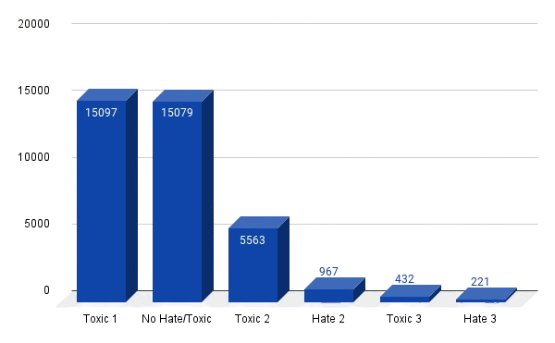
Class Imbalance

Slide 46
1. Class Imbalance

Slide 47
1. Class Imbalance
Toxic 3
No Hate/Toxic

Slide 48
1. Class Imbalance
Hate 3
Toxic 1
Toxic 3
No Hate/Toxic

Slide 49
1. Class Imbalance
Hate 2
Hate 3
Toxic 3
Toxic 2
Toxic 1
No Hate/Toxic

Slide 50
1. Class Imbalance
Hate 2
Hate 3
Toxic 3
Toxic 2
Hate 1
Toxic 1
No Hate/Toxic

Slide 51
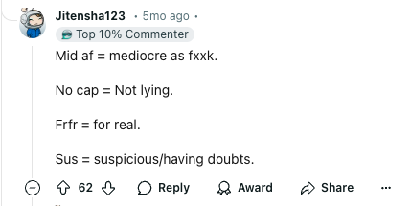
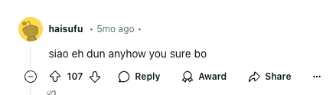
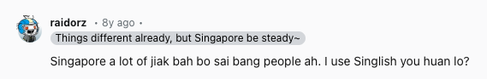
2. Singlish and Language Nuances

Slide 52
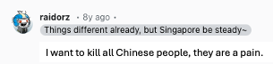
3. Complexity of Analysis
Race
Crimes

Slide 53
3. Complexity of Analysis
Race

Slide 54
08
Future Directions

Slide 55


Model Improvements
Hate 2
Hate 3
Toxic 3

Slide 56


Real-Time Monitoring

Slide 57
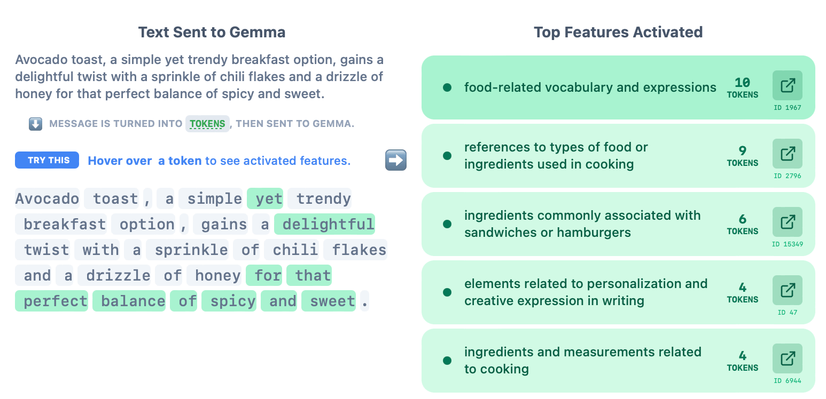
Explainability

Slide 58

Notes:
mood

Slide 59
09
Live Demo

Slide 60
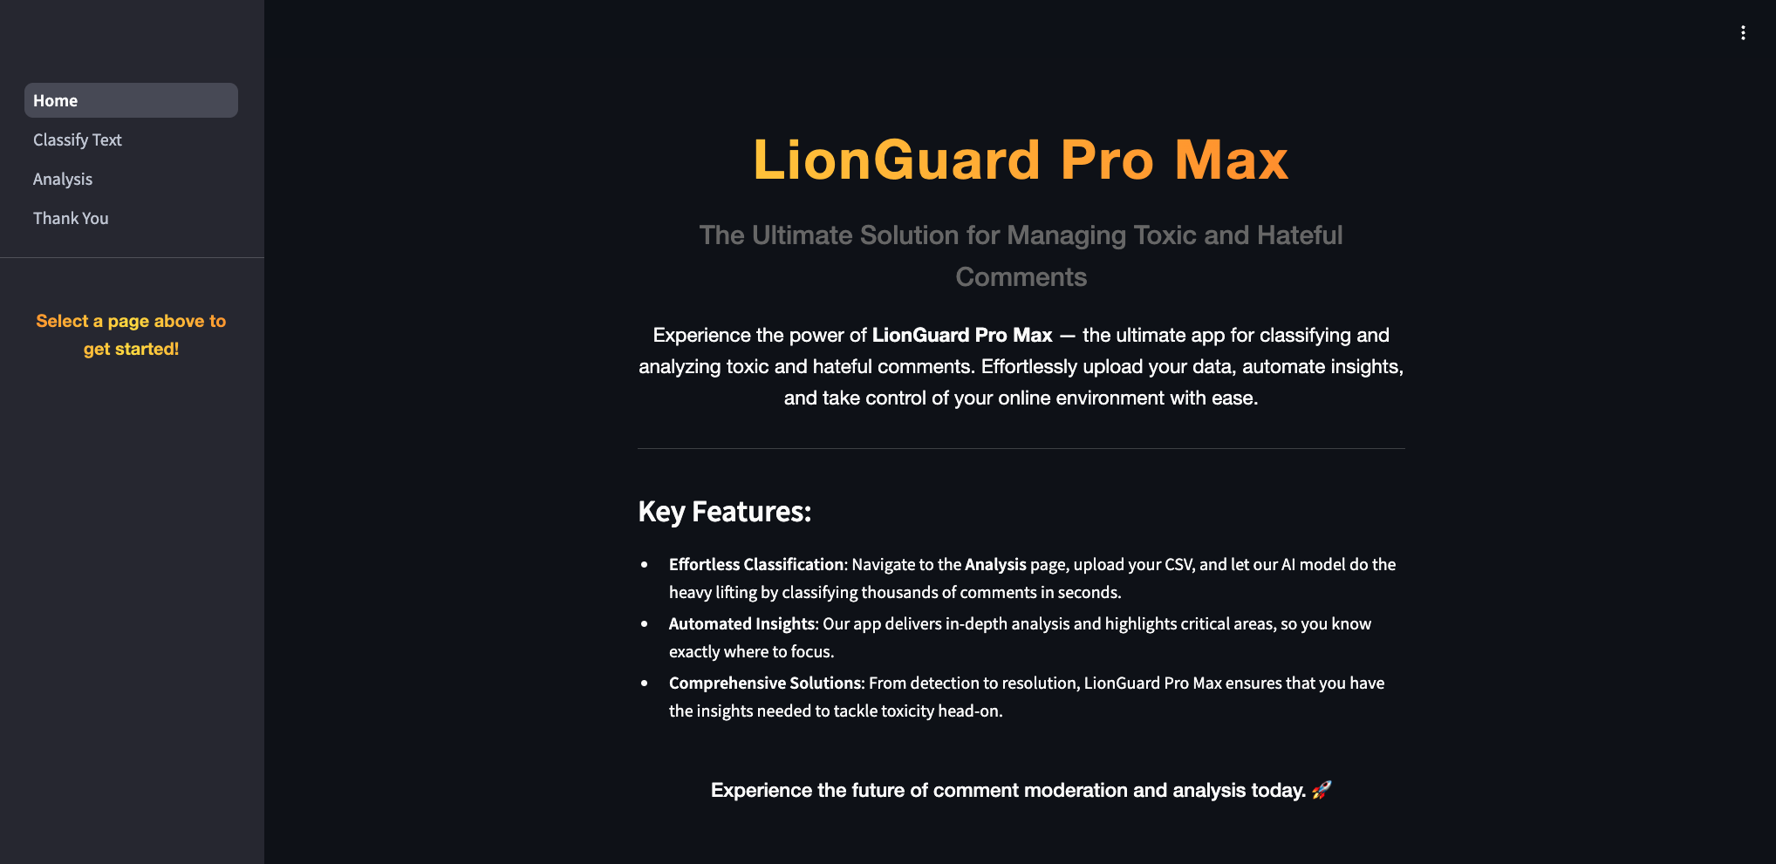

Slide 61
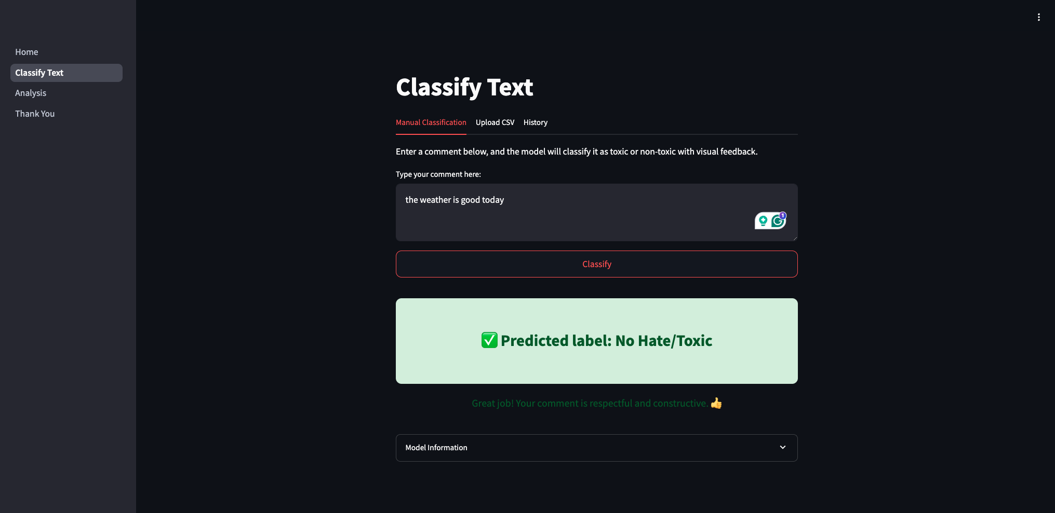

Slide 62
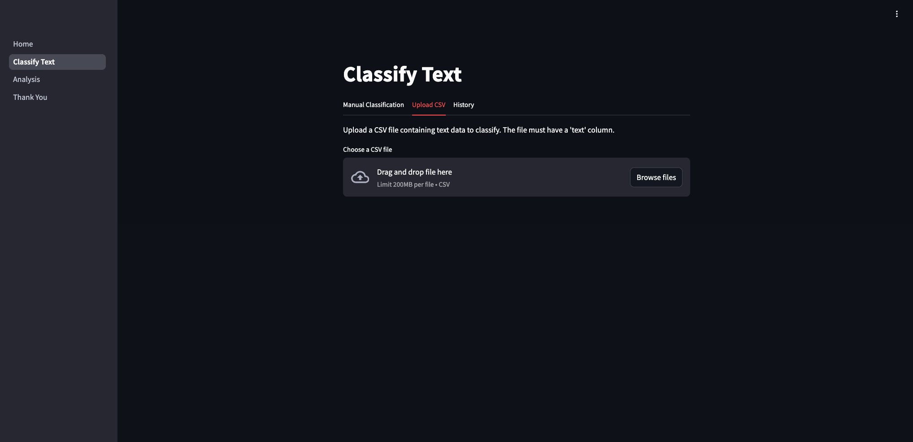

Slide 63
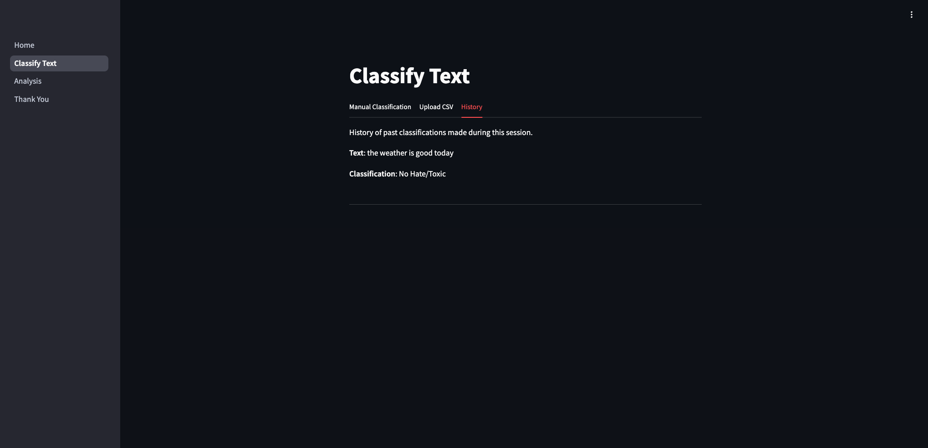

Slide 64
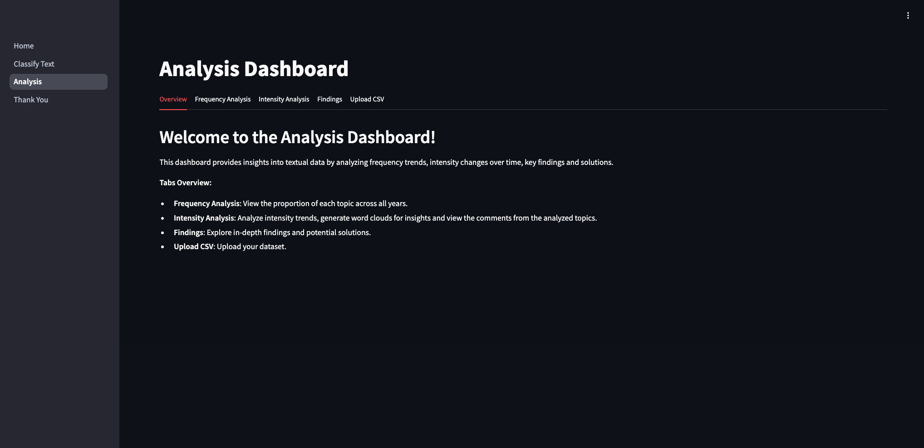

Slide 65
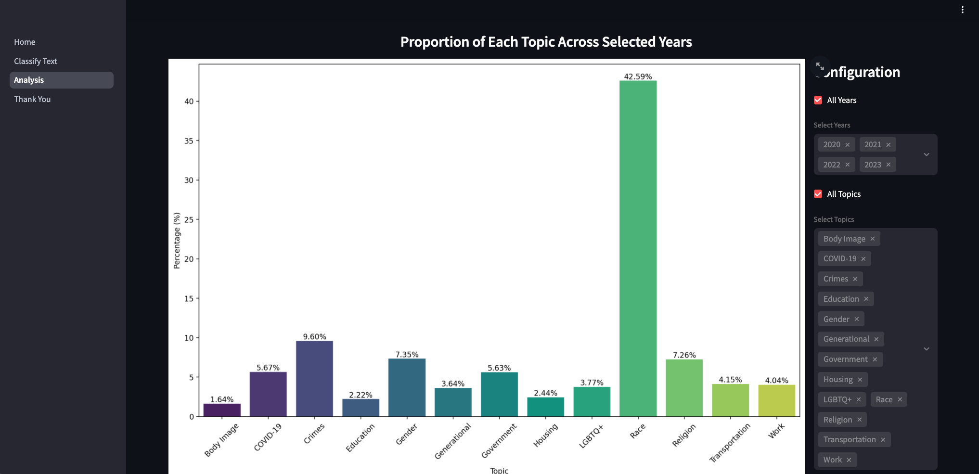

Slide 66
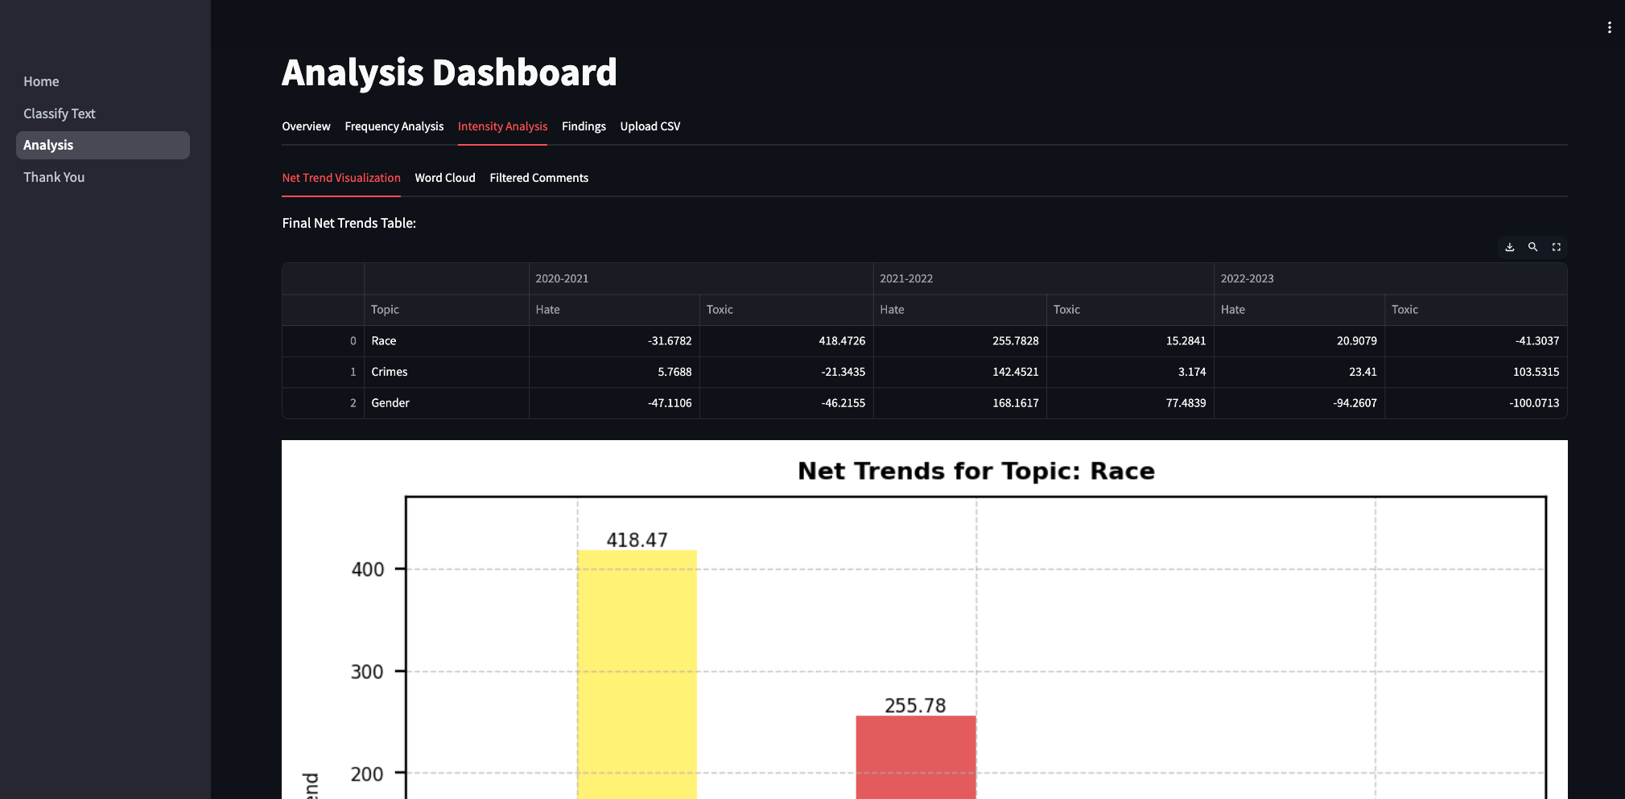

Slide 67
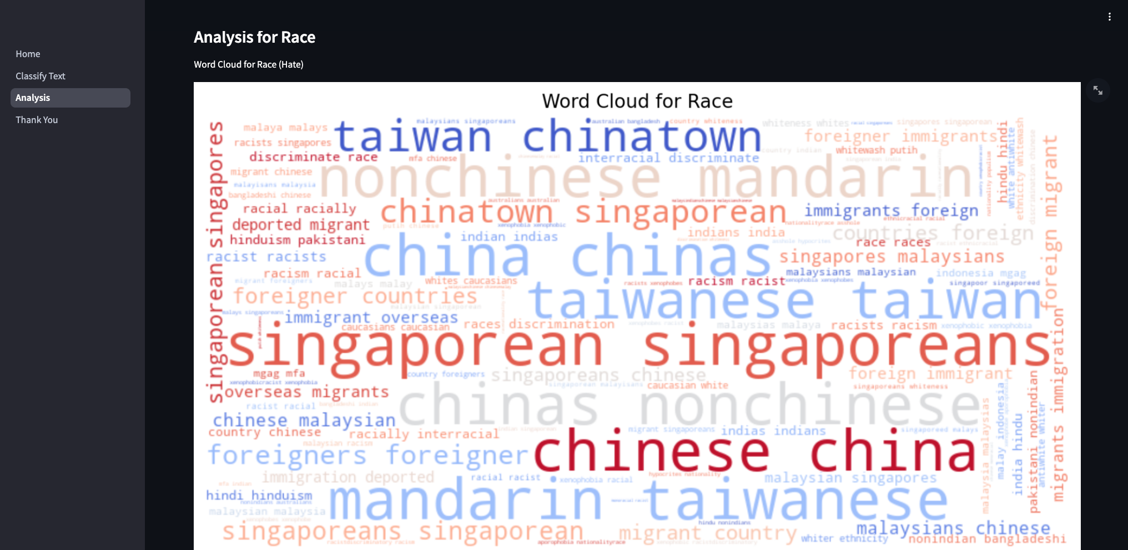

Slide 68
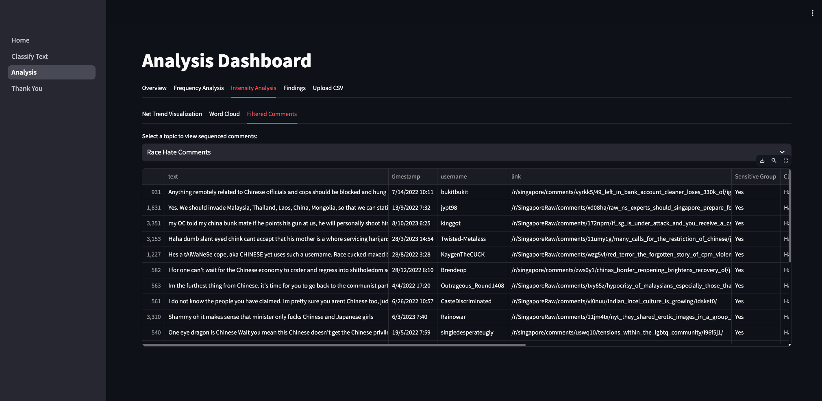

Slide 69
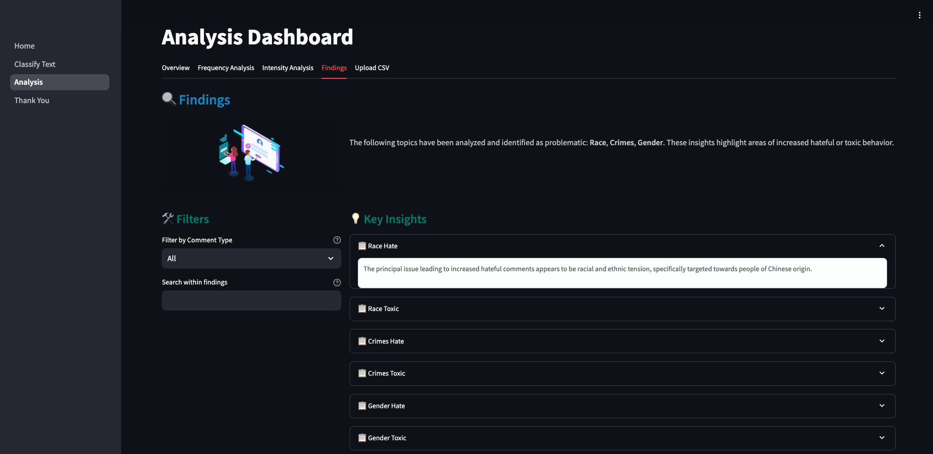

Slide 70
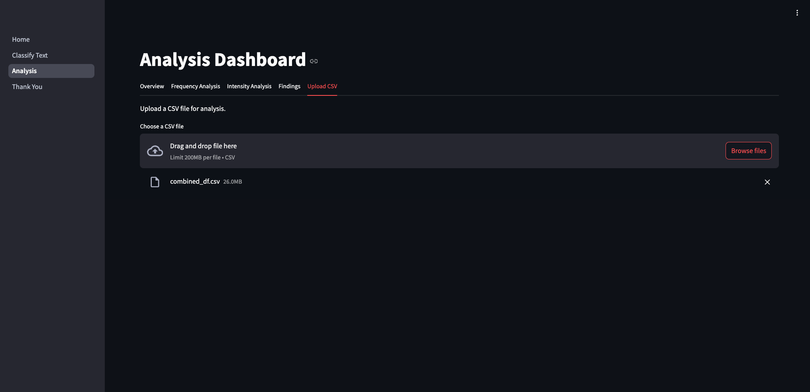

Slide 71


For those who can’t scan: http://detoxify.a.pinggy.link
Notes:
Things to show: 1. Our app with the 2 dashboards 2. Classify - Show the live classification of texts, and in other languages too 3. Analysis - Show live upload of csv, downloadable and interactive graphs, insights
# 5k
# i love the weather today (No Hate/Toxic)
# (Hate 1)
# you are a damn bloody useless gay, dont you step foot into my place (Hate 2)
# deport all the useless migrants back to their home, if they dont leave asap, i will destroy them (Hate 3)
# It's the department, want to stir shit also cannot stir properly (Toxic 1)
# you are such a loser in life (Toxic 2)
# you are such a loser in life, get out of this place or else i will kick you (Toxic 3)
# Hate 1
我永远不会招募印度人进入我的公司 (Chinese)
Saya tidak akan pernah merekrut orang India ke dalam syarikat saya (Malay)
நான் ஒருபோதும் இந்தியர்களை எனது நிறுவனத்தில் சேர்க்க மாட்டேன் (Tamil)
Nunca reclutaré indios para mi empresa. (Spanish)
Jeg vil aldri rekruttere indianere til selskapet mitt (Norwegian)

Slide 72
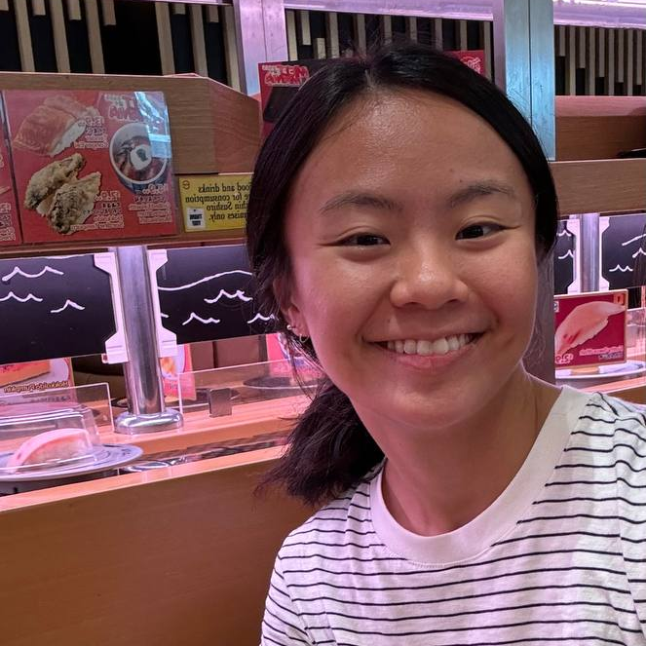



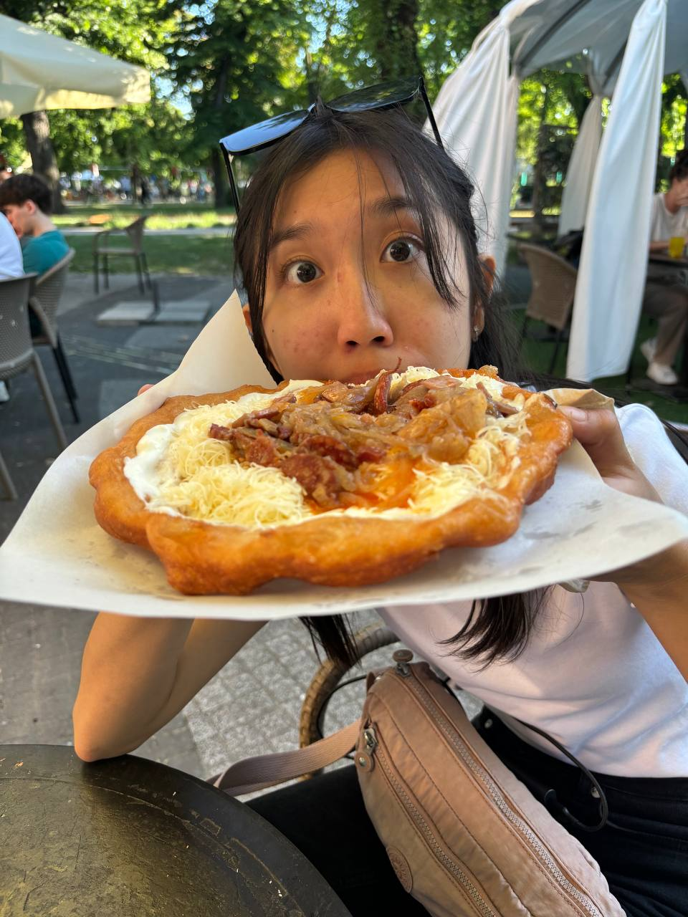
Thank you!
“LionGuard Pro Max is the best!”
“Simba approves this app”
—Joy Tan Syin Yee
—Richmond
“Guarding like a lion”
“Roaring past toxic and hate”
—Kylie
—Sarah
“Can’t spell safe without LionGuard Pro Max”
—Yi Jing

